Slide 1
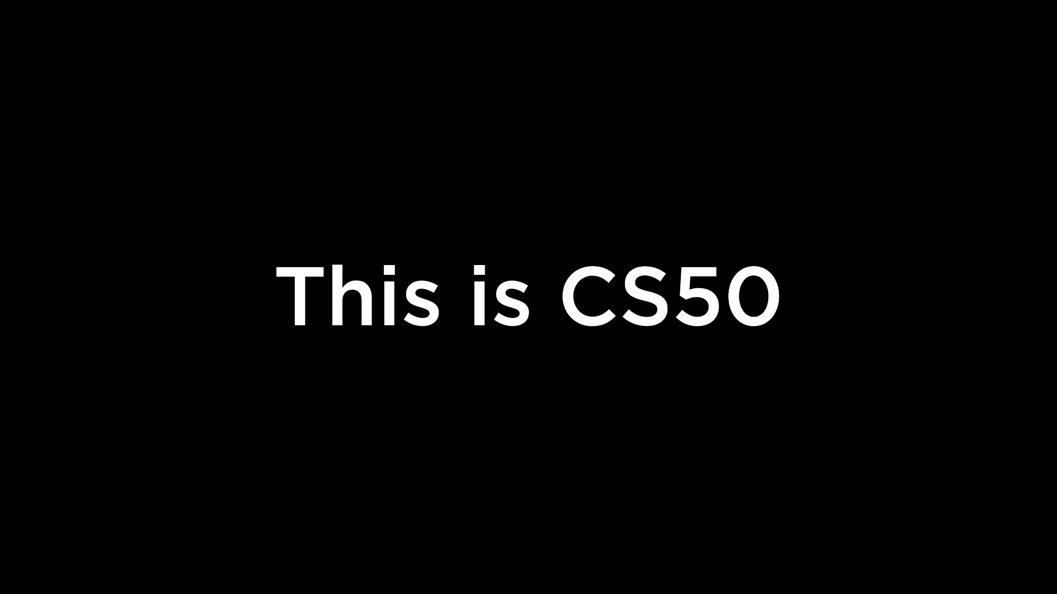
Notes:
Reload codespace
Uncheck VS Code tabs

Slide 2
This is CS50
Visit cs50.ly/screen to view projector on your laptop (and ask Carter questions).
Visit cs50.dev if you'd like to try writing some code during class, but no need to!
If you see an error logging in, not to worry, we'll solve after class!
We'll take a break partway through class, with cookies for snacks! 🍪
Looking for a study buddy? Submit cs50.ly/study.
Do say hi or ask more questions during break or after class!
Notes:
https://www.youtube.com/watch?v=7qirrV8w5SQ

Slide 4
learn how to program in Scratch

Slide 5
learn how to program in C

Slide 6
learn how to solve problems

Slide 7
learn how to solve problems with functions

Slide 8
learn how to solve problems with variables

Slide 9
learn how to solve problems with conditionals

Slide 10
learn how to solve problems with loops

Slide 11
learn how (not) to solve problems
Notes:
overflow, imprecision

Slide 12
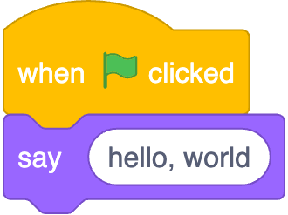
Notes:
https://scratchblocks.github.io/#?style=scratch3&script=when%20green%20flag%20clicked%0Asay%20%5Bhello%2C%20world%5D

Slide 13
#include <stdio.h>
int main(void) {
printf("hello, world\n");
}

Slide 14
#include <stdio.h>
int main(void) {
printf("hello, world\n");
}

Slide 15
source code

Slide 16
01111111 01000101 01001100 01000110 00000010 00000001 00000001 00000000 00000000 00000000 00000000 00000000 00000000 00000000 00000000 00000000 00000010 00000000 00111110 00000000 00000001 00000000 00000000 00000000 10110000 00000101 01000000 00000000 00000000 00000000 00000000 00000000 01000000 00000000 00000000 00000000 00000000 00000000 00000000 00000000 11010000 00010011 00000000 00000000 00000000 00000000 00000000 00000000 00000000 00000000 00000000 00000000 01000000 00000000 00111000 00000000 00001001 00000000 01000000 00000000 00100100 00000000 00100001 00000000 00000110 00000000 00000000 00000000 00000101 00000000 00000000 00000000 01000000 00000000 00000000 00000000 00000000 00000000 00000000 00000000 01000000 00000000 01000000 00000000 00000000 00000000 00000000 00000000 01000000 00000000 01000000 00000000 00000000 00000000 00000000 00000000 11111000 00000001 00000000 00000000 00000000 00000000 00000000 00000000 11111000 00000001 00000000 00000000 00000000 00000000 00000000 00000000 00001000 00000000 00000000 00000000 00000000 00000000 00000000 00000000 00000011 00000000 00000000 00000000 00000100 00000000 00000000 00000000 00111000 00000010 00000000 00000000 00000000 00000000 00000000 00000000 ...

Slide 17
machine code

Slide 18
input →
→ output
Notes:
starting today, no green flag

Slide 20
source code →

Slide 21
source code →
→ machine code

Slide 22
compiler
source code →
→ machine code

Slide 23
Visual Studio Code for CS50
cs50.dev
Notes:
where to write, compile code

Slide 24
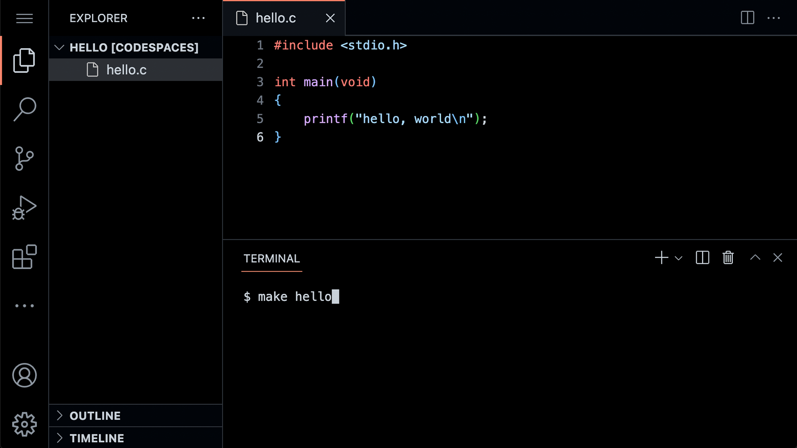

Slide 29
#include <stdio.h>
int main(void) {
printf("hello, world\n");
}
Notes:
hello0.c

Slide 30
code hello.c
make hello
./hello
single dot is current folder
double dot is parent folder

Slide 31
Notes:
https://scratchblocks.github.io/#?style=scratch3&script=when%20green%20flag%20clicked%0Asay%20%5Bhello%2C%20world%5D
let's focus on this function

Slide 32
function
arguments →
→ side effects

Slide 33
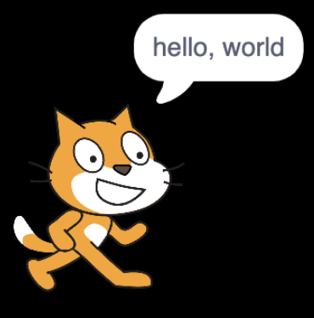


→
→
Notes:
https://scratchblocks.github.io/#?style=scratch3&script=say%20%5B%5D
https://scratchblocks.github.io/#?style=scratch3&script=say%20%5Bhello%2C%20world%5D

Slide 34

printf("hello, world\n");
Notes:
https://scratchblocks.github.io/#?style=scratch3&script=say%20%5Bhello%2C%20world%5D

Slide 35
printf("hello, world\n");

Slide 36
printf("hello, world\n");

Slide 37
printf("hello, world\n");

Slide 38
printf("hello, world\n");

Slide 39
printf("hello, world\n");

Slide 40
printf("hello, world\n");
Notes:
lot of ways to make mistakes; try omitting semicolon

Slide 41
escape sequences
Notes:
try omitting \n

Slide 42
header files
Notes:
try removing stdio.h

Slide 43
libraries

Slide 44
Manual Pages
manual.cs50.io

Slide 45
stdio.h

Slide 46
manual.cs50.io/#stdio.h

Slide 47
manual.cs50.io/3/printf

Slide 48
cs50.h

Slide 49
manual.cs50.io/#cs50.h

Slide 50
get_char
get_double
get_float
get_int
get_long
get_string
...

Slide 51
get_char
get_double
get_float
get_int
get_long
get_string
...

Slide 52
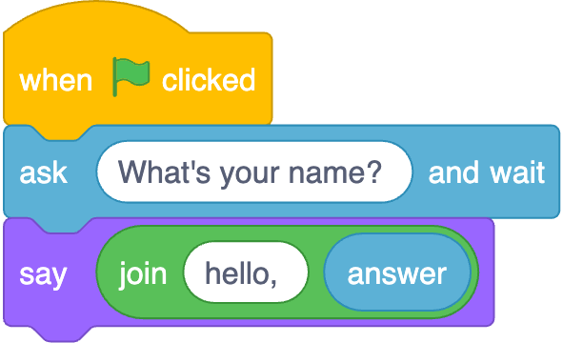
Notes:
https://scratchblocks.github.io/#?style=scratch3&script=when%20green%20flag%20clicked%0Aask%20%5BWhat's%20your%20name%3F%20%5D%20and%20wait%0Asay(join%20%5Bhello%2C%20%5D%20(answer))

Slide 53
function
arguments →
→ return value

Slide 54
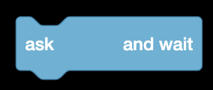
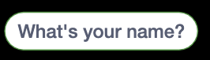

→
→
Notes:
https://scratchblocks.github.io/#?style=scratch3&script=ask%20%5B%5D%20and%20wait
https://scratchblocks.github.io/#?style=scratch3&script=ask%20%5BWhat's%20your%20name%3F%5D%20and%20wait
https://scratchblocks.github.io/#?style=scratch3&script=(answer)

Slide 55
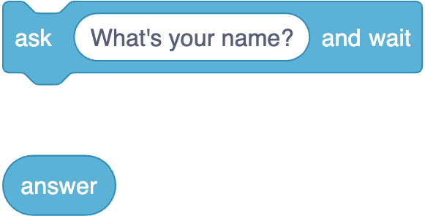
Notes:
https://scratchblocks.github.io/#?style=scratch3&script=ask%20%5BWhat's%20your%20name%3F%5D%20and%20wait%0A(answer)

Slide 56
string answer = get_string( );
printf("hello, %s", answer);

Slide 57
string answer = get_string("What's your name? ");
printf("hello, %s", answer);

Slide 58
string answer = get_string("What's your name? ");
printf("hello, %s", answer);

Slide 59
string answer = get_string("What's your name? ");
printf("hello, %s", answer);

Slide 60
string answer = get_string("What's your name? ");
printf("hello, %s", answer);

Slide 61
string answer = get_string("What's your name? ");
printf("hello, %s", answer);
Notes:
hello1.c

Slide 62
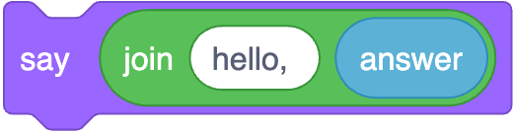
printf("hello, %s", answer);
Notes:
https://scratchblocks.github.io/#?style=scratch3&script=say%20(join%5Bhello%2C%20%5D%20(answer)%0A

Slide 63
printf("hello, %s\n", answer);

Slide 64
printf("hello, %s\n", answer);

Slide 65
printf("hello, %s\n", answer);

Slide 66
printf("hello, %s\n", answer);

Slide 67
printf("hello, %s\n", answer);
Notes:
hello2.c

Slide 68
types

Slide 69
bool
char
double
float
int
long
string
...

Slide 70
bool
char
double
float
int
long
string
...

Slide 71
bool
char
double
float
int
long
string
...

Slide 72
get_char
get_double
get_float
get_int
get_long
get_string
...

Slide 73
get_char
get_double
get_float
get_int
get_long
get_string
...

Slide 74
format codes

Slide 75
%c
%f
%i
%li
%s

Slide 76
%c
%f
%i
%li
%s

Slide 77
%c
%f
%i
%li
%s

Slide 78
conditionals

Slide 79
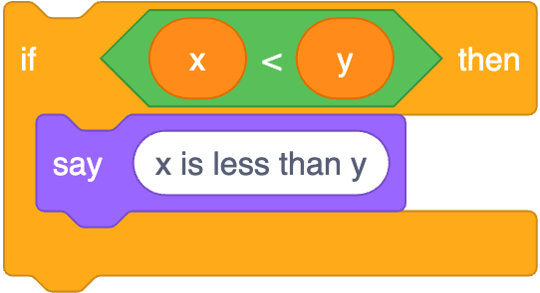
if (x < y) {
printf("x is less than y\n");
}
Notes:
https://scratchblocks.github.io/#?style=scratch3&script=if%20%3C(x)%20%3C%20(y)%3E%20then%0Asay%20%5Bx%20is%20less%20than%20y%5D

Slide 80
if (x < y) {
printf("x is less than y\n");
}

Slide 81
if (x < y) {
printf("x is less than y\n");
}

Slide 82
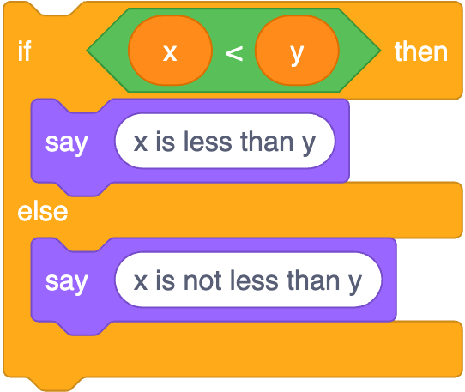
if (x < y) {
printf("x is less than y\n");
}
else
{ printf("x is not less than y\n");
}
Notes:
https://scratchblocks.github.io/#?style=scratch3&script=if%20%3C(x)%20%3C%20(y)%3E%20then%0Asay%20%5Bx%20is%20less%20than%20y%5D%0Aelse%0Asay%20%5Bx%20is%20not%20less%20than%20y%5D

Slide 83
if (x < y) {
printf("x is less than y\n");
}
else
{ printf("x is not less than y\n");
}

Slide 84
if (x < y) {
printf("x is less than y\n");
}
else
{ printf("x is not less than y\n");
}

Slide 85
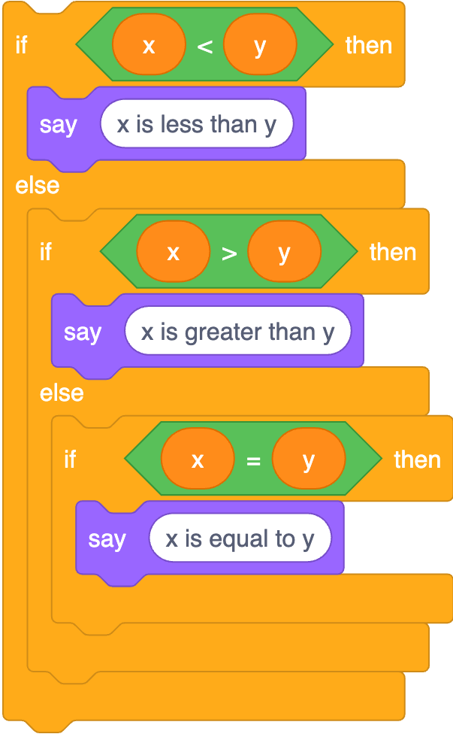
if (x < y) {
printf("x is less than y\n");
}
else if (x > y)
{ printf("x is greater than y\n");
}
else if (x == y)
{ printf("x is equal to y\n");
}
Notes:
https://scratchblocks.github.io/#?style=scratch3&script=if%20%3C(x)%20%3C%20(y)%3E%20then%0Asay%20%5Bx%20is%20less%20than%20y%5D%0Aelse%0Aif%20%3C(x)%20%3E%20(y)%3E%20then%0Asay%20%5Bx%20is%20greater%20than%20y%5D%0Aelse%0Aif%20%3C(x)%20%3D%20(y)%3E%20then%0Asay%20%5Bx%20is%20equal%20to%20y%5D

Slide 86
if (x < y) {
printf("x is less than y\n");
}
else if (x > y)
{ printf("x is greater than y\n");
}
else if (x == y)
{ printf("x is equal to y\n");
}

Slide 87
if (x < y) {
printf("x is less than y\n");
}
else if (x > y)
{ printf("x is greater than y\n");
}
else if (x == y)
{ printf("x is equal to y\n");
}

Slide 88
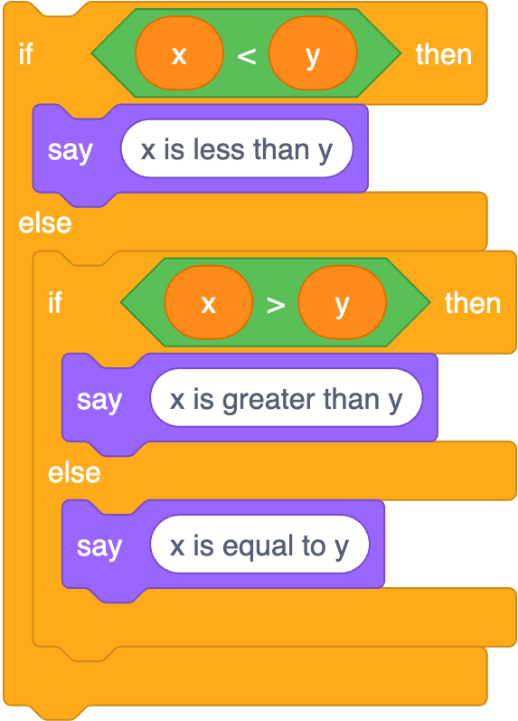
if (x < y) {
printf("x is less than y\n");
}
else if (x > y)
{ printf("x is greater than y\n");
}
else
{ printf("x is equal to y\n");
}
Notes:
https://scratchblocks.github.io/#?style=scratch3&script=if%20%3C(x)%20%3C%20(y)%3E%20then%0Asay%20%5Bx%20is%20less%20than%20y%5D%0Aelse%0Aif%20%3C(x)%20%3E%20(y)%3E%20then%0Asay%20%5Bx%20is%20greater%20than%20y%5D%0Aelse%0Asay%20%5Bx%20is%20equal%20to%20y%5D

Slide 89
variables

Slide 90
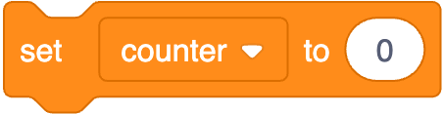
int counter = 0;
Notes:
https://scratchblocks.github.io/#?style=scratch3&script=set%20%5Bcounter%20v%5D%20to%20%5B0%5D

Slide 91
int counter = 0;

Slide 92
int counter = 0;

Slide 93
int counter = 0;

Slide 94

counter = counter + 1;
Notes:
https://scratchblocks.github.io/#?style=scratch3&script=change%20%5Bcounter%20v%5D%20by%20%5B1%5D

Slide 95
counter = counter + 1;;

Slide 96
counter += 1;

Slide 97
counter++;

Slide 98

counter--;
Notes:
https://scratchblocks.github.io/#?style=scratch3&script=change%20%5Bcounter%20v%5D%20by%20%5B-1%5D

Slide 100
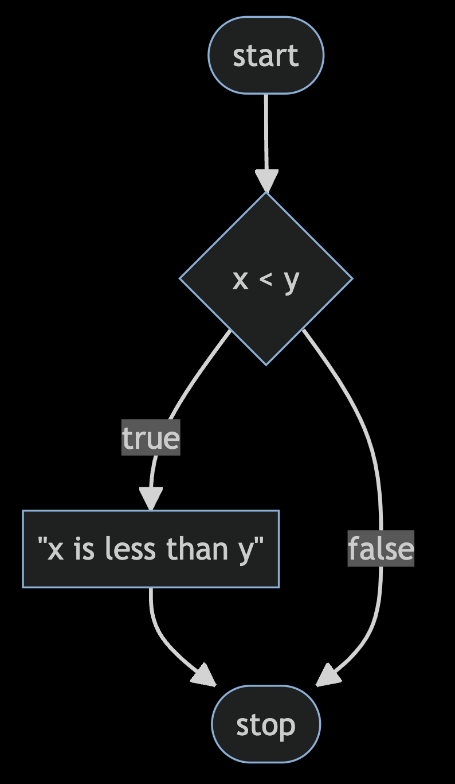
Notes:
compare0.c
https://mermaid.live/edit#pako:eNpNkMFugzAMhl_F8i5Dgheg06QBO-7UntZwsEg6UCGhidFAiHdfSMY0n-zvt39bXrExUmGOt958Ny1ZhkslNPh4e7469qBOIMteoVhneIFli2LhGbCdVNDKq8Cnx2T4NEPnoFfOAbekYYlUYB3HytBe7c5mrJN_XjfqXTT7XY8pDsoO1El_3bozgdyqQQnMfSrJ3gUKvfk-mticF91gvl-U4jRKYlV19GVpwDxYH_RddmzsH1Sh_Ig_CK9IcST9acwxuP0A4V5a9A

Slide 101
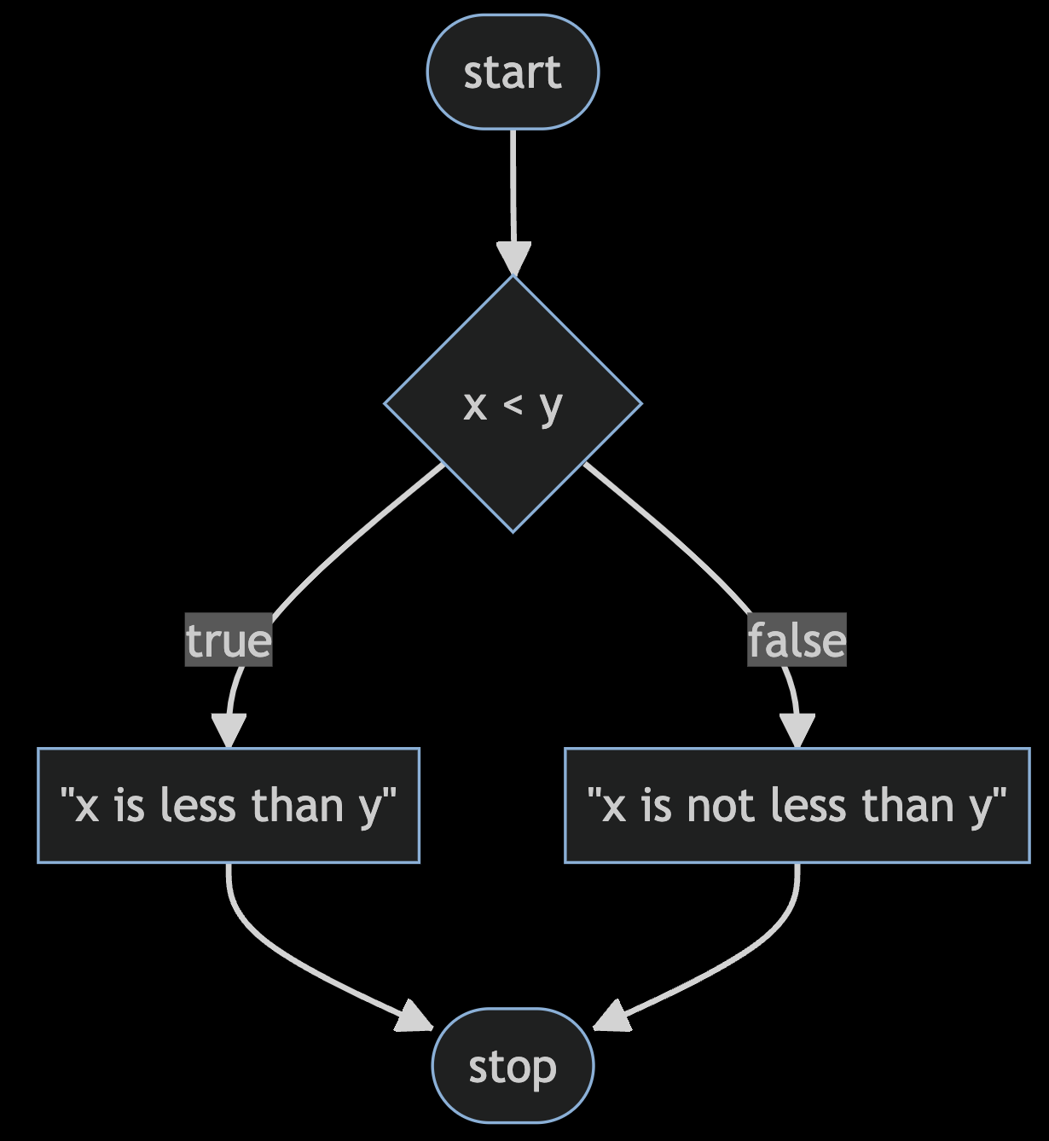
Notes:
compare1.c
https://mermaid.live/edit#pako:eNp9kMFugzAMhl_F8i6rRF-AVZXWwrGn7rSGg0XSgQoxS4xWhHj3hUSdtst8sv_f_mR7xpq1wRyvHX_VDTmBt0JZCPH6fPEShGoD2-0eDvMddjAtyTwEDcSNJnrHi8Knz5Hl5Q6th854D9KQhSmpCqs0doztxUrmodr8Yl2p8wlW_oVZln-AZQKuKWbYG9dTq8M582orlMb0RmEeUk3uplDZJfTRKHyebI35ekKG46BJTNHSh6Me87jLQy11K-x-RBPLU3pa_F2GA9l35sfg8g0ckGn4

Slide 102
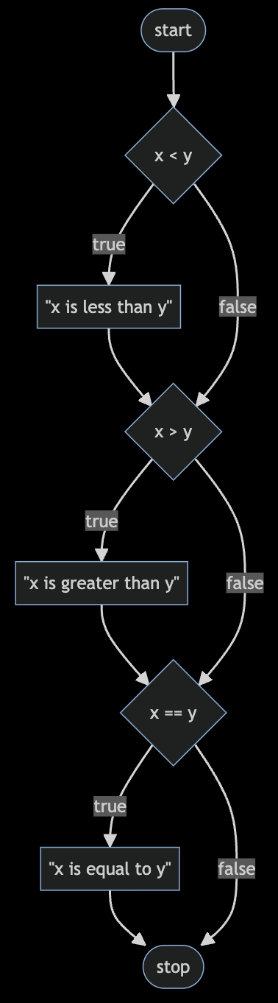
Notes:
compare2.c
https://mermaid.live/edit#pako:eNptkcFugzAMhl_F8i6rRF-ArZXWBtrLTttpDQeLpAUNCE2CVoR494WgUtCWU_L792c77jBVQmKI50L9pBlpC5-MV-DO2_PJWCckK1ivt7DrbvAKbT8Gd04DqxvpY_sTx6dro-zLDXIDhTQGbEYVtKPKMRnT9t7OHGo7odgCFS1RFy3JSv0_LfIZsaNtNhMuXuAOS5y8NlSAVX9QB-8-DiOrOlnNhjxTYUYWm_X7UONZ2Yd6xABLqUvKhfvcbvBwtJksJcfQXQXpb4686p2PGqs-2irFcGg7wKYWbmaW00VTiaGH3tVI5FbpSZT--T6u0G8ywJqqL6Xuif0vYHGQ9A

Slide 103
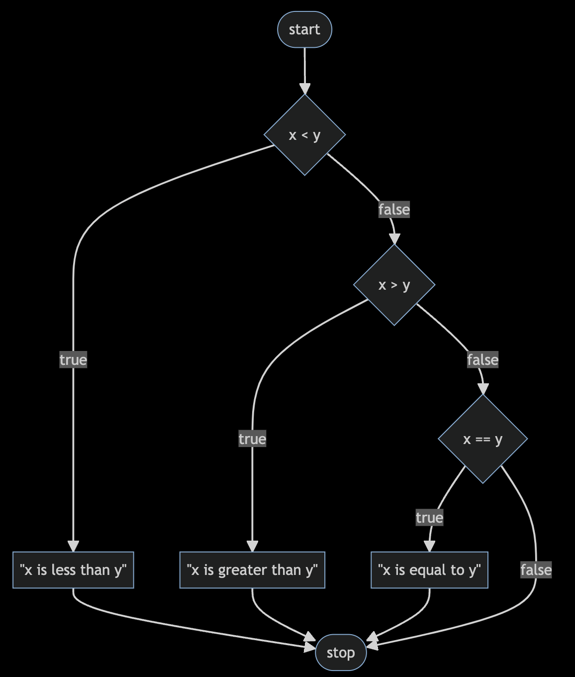
Notes:
compare3.c
https://mermaid.live/edit#pako:eNptkc9ugzAMxl_F8i6rRF-ArZXWhraXnbbTGg4WSQsqEJo_WhHi3RdAMNCWU77P9s-J3WCihMQQL7n6TlLSFj4ZL8Gft-ezsd6IV7Beb2HXPOAV6nYI7rwHVjvZx_Znjk93p-zLAzIDuTQGbEol1IPLMZ6VXSg3Qx3zzO3EZAtmtGRetSQr9f9YtsQePHazmbiHBfe45Mq7oxys-sM89tmnbgiqilcz1G-j0-Du5yIaBQZYSF1QJvx4my7I0aaykBxDfxWkbxx52fo8clZ91GWCYffMAF0l_GdZRldNBYZ9w9GNRGaVnkzZy_dhif0uA6yo_FJqLGx_AMcUkcQ

Slide 104
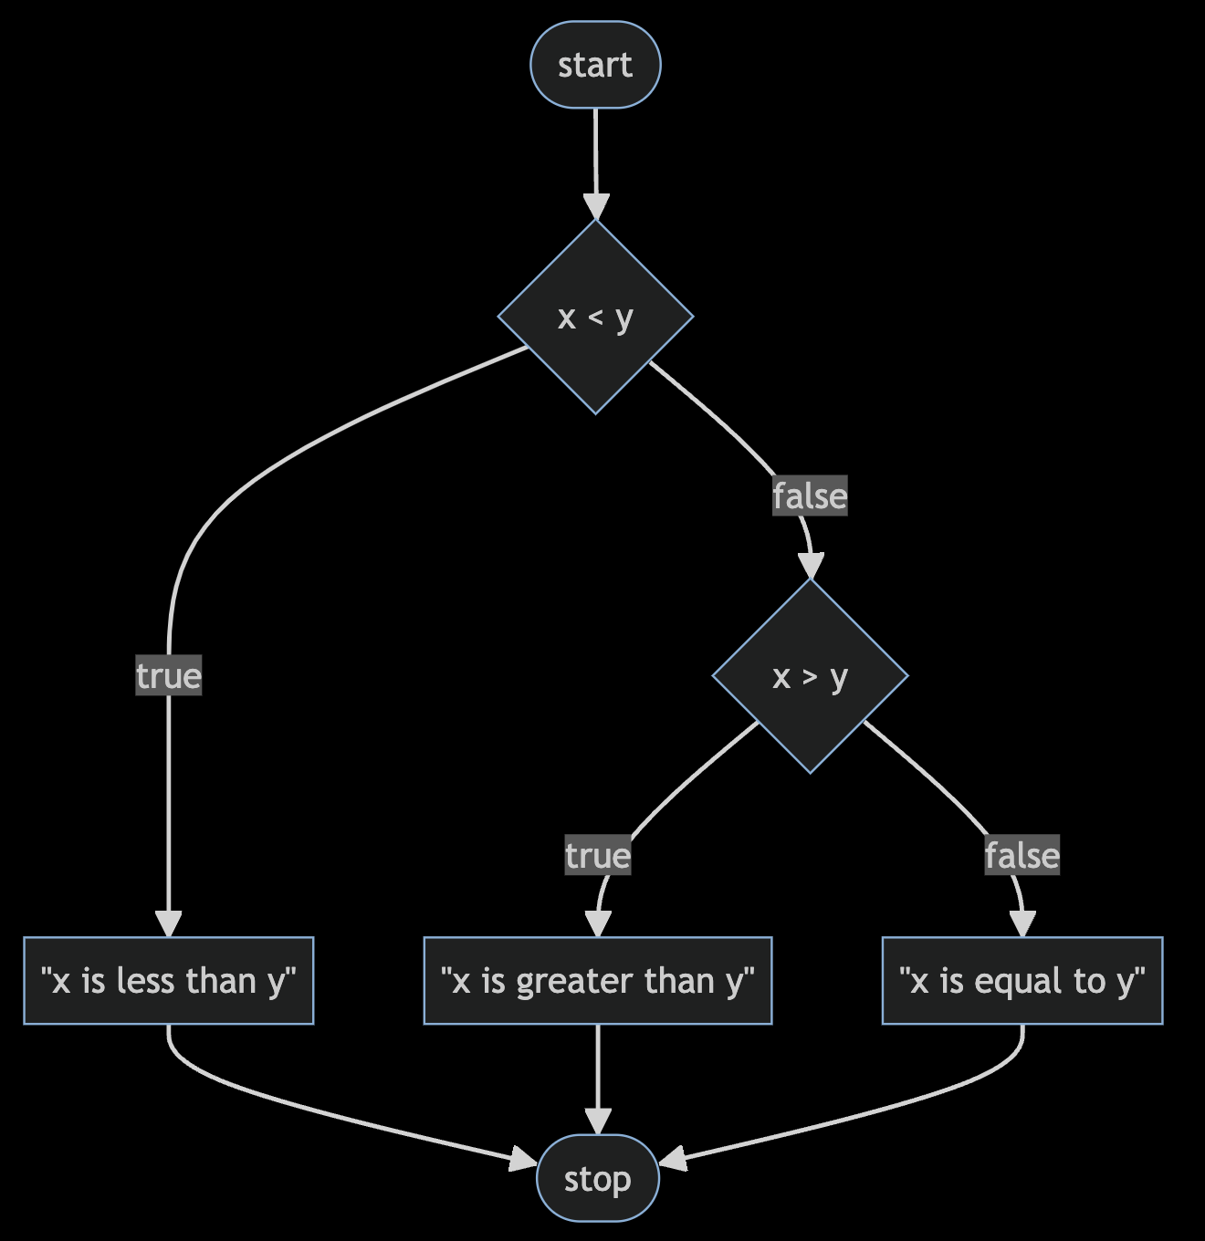
Notes:
compare4.c
https://mermaid.live/edit#pako:eNptkctOwzAQRX9lNGyolP5AQJVonYoNK1hRZzGK3SYisVM_RKMo_45jKxUReOU5M_dqHiNWWkjM8dzq76om4-CDcQXhvTyerAug3MB2u4P9eINnGKaU3AcGzngZc4cTx4er1-7pBo2FVloLriYFQ6Icy1-yM7U26Vjw3N092cqzWHtejCQnzf-2bG17XEvl1VMLTv-RHWP16zyn7stNgocEU1AsAWbYSdNRI8KuxjnJ0dWykxzz8BVkvjhyNYU68k6_D6rCfJ4lQ9-L0Dlr6GKowzy2udBCNE6bO5QxfEsXiYfJsCf1qfUinH4AYdKEwg

Slide 105
bool
char
double
float
int
long
string
...

Slide 106
bool
char
double
float
int
long
string
...

Slide 107
get_char
get_double
get_float
get_int
get_long
get_string
...

Slide 108
get_char
get_double
get_float
get_int
get_long
get_string
...
Notes:
agree{0,1,2}.c

Slide 109
loops
Notes:
meow0.c

Slide 110
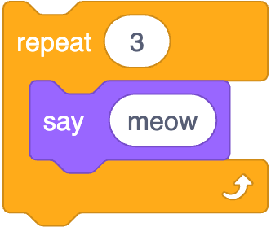
Notes:
https://scratchblocks.github.io/#?style=scratch3&script=repeat%20%5B3%5D%0Asay%5Bmeow%5D

Slide 111
int counter = 3;
while (counter > 0)
{
printf("meow\n");
counter = counter - 1;
}

Slide 112
int counter = 3;
while (counter > 0)
{
printf("meow\n");
counter = counter - 1;
}

Slide 113
int counter = 3;
while (counter > 0)
{
printf("meow\n");
counter = counter - 1;
}

Slide 114
int counter = 3;
while (counter > 0)
{
printf("meow\n");
counter = counter - 1;
}

Slide 115
int counter = 3;
while (counter > 0)
{
printf("meow\n");
counter = counter - 1;
}

Slide 116
int counter = 3;
while (counter > 0)
{
printf("meow\n");
counter = counter - 1;
}

Slide 117
int counter = 3;
while (counter > 0)
{
printf("meow\n");
counter = counter - 1;
}

Slide 118
int counter = 3;
while (counter > 0)
{
printf("meow\n");
counter = counter - 1;
}

Slide 119
int counter = 3;
while (counter > 0)
{
printf("meow\n");
counter = counter - 1;
}

Slide 120
int counter = 3;
while (counter > 0)
{
printf("meow\n");
counter = counter - 1;
}

Slide 121
int counter = 3;
while (counter > 0)
{
printf("meow\n");
counter = counter - 1;
}

Slide 122
int counter = 3;
while (counter > 0)
{
printf("meow\n");
counter = counter - 1;
}

Slide 123
int counter = 3;
while (counter > 0)
{
printf("meow\n");
counter = counter - 1;
}

Slide 124
int counter = 3;
while (counter > 0)
{
printf("meow\n");
counter = counter - 1;
}

Slide 125
int i = 3;
while (i > 0)
{
printf("meow\n");
i = i - 1;
}

Slide 126
int i = 3;
while (i > 0)
{
printf("meow\n");
i -= 1;
}

Slide 127
int i = 3;
while (i > 0)
{
printf("meow\n");
i--;
}
Notes:
meow{1,2}.c

Slide 128
int i = 3;
while (i > 0)
{
printf("meow\n");
i--;
}
Notes:
bowl of 3 stressballs

Slide 129
int i = 1;
while (i <= 3)
{
printf("meow\n");
i++;
}

Slide 130
int i = 0;
while (i < 3)
{
printf("meow\n");
i++;
}
Notes:
meow3.c

Slide 131
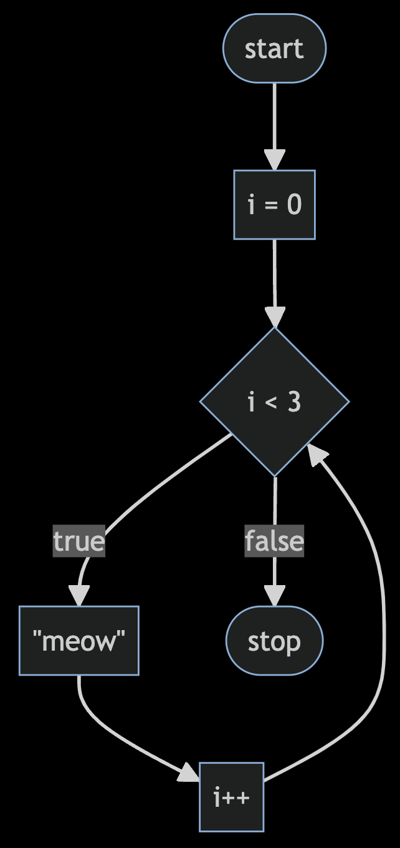
Notes:
https://mermaid.live/edit#pako:eNpNkEFvwjAMhf-KZS4gioS0WzeQgHa3ncaJpgerSUc0EnchFZqq_velCUz4ZH9-fnrygA1LhTm2F741Z3IejoWwEGo3r64-gHoBq9UW9pWGDazrtNxHdhg0vMHLmNghMPCuV3FXVAJnPz37V6P4ljqB9_MiSspKL5d3UibDJ6eWLtdk9T4l4a5eCIsZGuUMaRkyD5NaoD8rowTmoZXkvgUKOwYd9Z4_f22D-ZQpw76T5FWh6cuRwTzaP2gptWf3D1UcP9Jn4oMy7MiemB-H4x_2fV7F

Slide 132
int i = 0;
while (i < 3)
{
printf("meow\n");
i++;
}

Slide 133
for (int i = 0; i < 3; i++)
{
printf("meow\n");
}

Slide 134
for (int i = 0; i < 3; i++)
{
printf("meow\n");
}

Slide 135
for (int i = 0; i < 3; i++)
{
printf("meow\n");
}

Slide 136
for (int i = 0; i < 3; i++)
{
printf("meow\n");
}

Slide 137
for (int i = 0; i < 3; i++)
{
printf("meow\n");
}

Slide 138
for (int i = 0; i < 3; i++)
{
printf("meow\n");
}

Slide 139
for (int i = 0; i < 3; i++)
{
printf("meow\n");
}

Slide 140
for (int i = 0; i < 3; i++)
{
printf("meow\n");
}

Slide 141
for (int i = 0; i < 3; i++)
{
printf("meow\n");
}

Slide 142
for (int i = 0; i < 3; i++)
{
printf("meow\n");
}

Slide 143
for (int i = 0; i < 3; i++)
{
printf("meow\n");
}

Slide 144
for (int i = 0; i < 3; i++)
{
printf("meow\n");
}

Slide 145
for (int i = 0; i < 3; i++)
{
printf("meow\n");
}
Notes:
meow4.c

Slide 146
Notes:
https://mermaid.live/edit#pako:eNpNkEFvwjAMhf-KZS4gioS0WzeQgHa3ncaJpgerSUc0EnchFZqq_velCUz4ZH9-fnrygA1LhTm2F741Z3IejoWwEGo3r64-gHoBq9UW9pWGDazrtNxHdhg0vMHLmNghMPCuV3FXVAJnPz37V6P4ljqB9_MiSspKL5d3UibDJ6eWLtdk9T4l4a5eCIsZGuUMaRkyD5NaoD8rowTmoZXkvgUKOwYd9Z4_f22D-ZQpw76T5FWh6cuRwTzaP2gptWf3D1UcP9Jn4oMy7MiemB-H4x_2fV7F

Slide 147
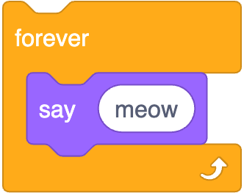
while (true)
{
printf("meow\n");
}
Notes:
https://scratchblocks.github.io/#?style=scratch3&script=forever%0Asay%5Bmeow%5D

Slide 148
while ( )
{
}

Slide 149
while (true)
{
}

Slide 150
while (true)
{
printf("meow\n");
}

Slide 151
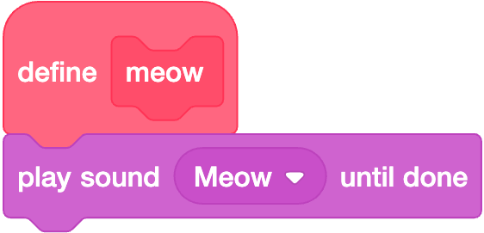

Slide 152
void meow(void)
{
printf("meow\n");
}

Slide 153
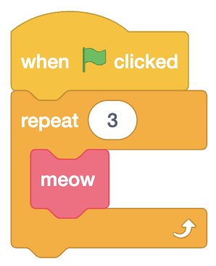

Slide 154
int main(void)
{
for (int i = 0; i < 3; i++)
{
meow();
}
}
Notes:
meow5.c

Slide 155
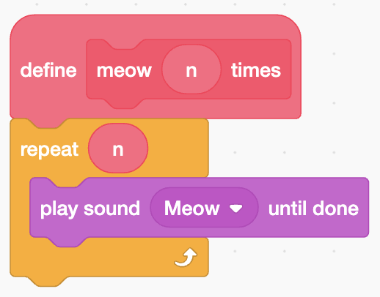

Slide 156
void meow(int n)
{
for (int i = 0; i < n; i++)
{
printf("meow\n");
}
}

Slide 157
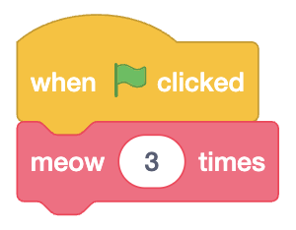

Slide 158
int main(void)
{
meow(3);
}
Notes:
meow6.c

Slide 159
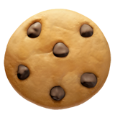
Notes:
https://emojipedia.org/cookie/

Slide 160
function
arguments →
→ side effects

Slide 161
function
arguments →
→ return value
Notes:
calculator0.c

Slide 162
+
-
*
/
%

Slide 163
scope
Notes:
calculator{1,2,3}.c

Slide 164

Notes:
https://editor.codecogs.com/

Slide 165

Notes:
https://editor.codecogs.com/

Slide 166
Linux

Slide 167
graphical user interface

Slide 168
GUI

Slide 171
command-line interface

Slide 172
CLI

Slide 173
cd
cp
ls
mkdir
mv
rm
rmdir
...

Slide 174
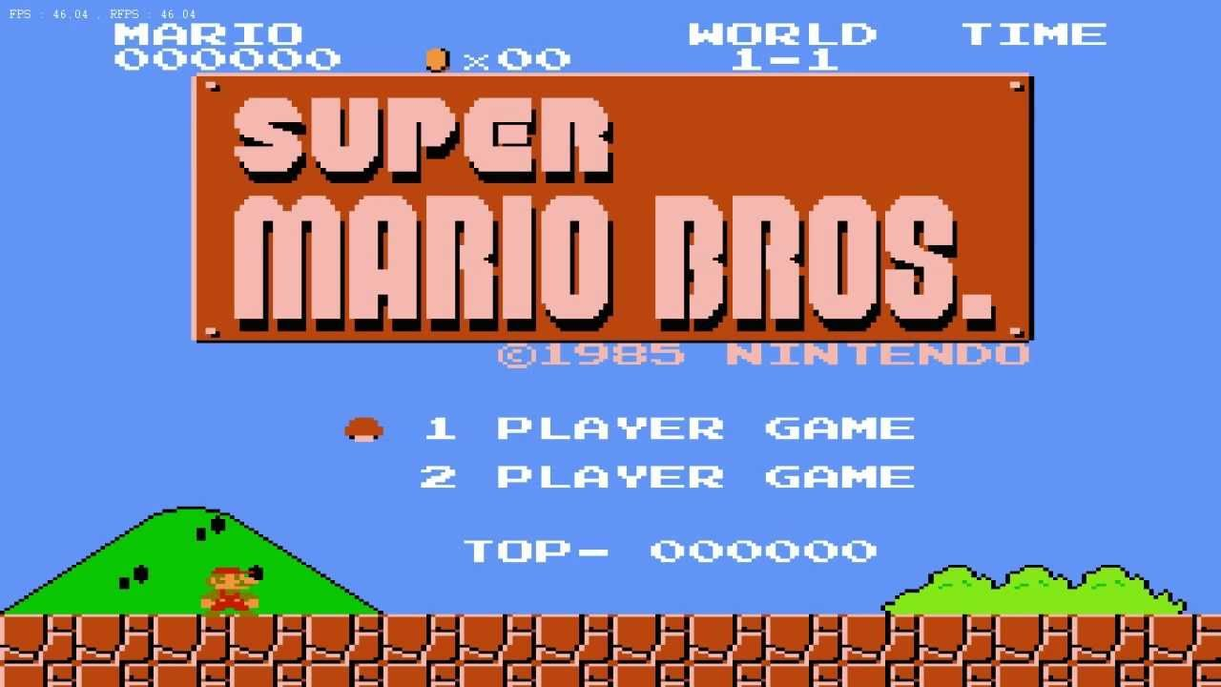

Slide 175
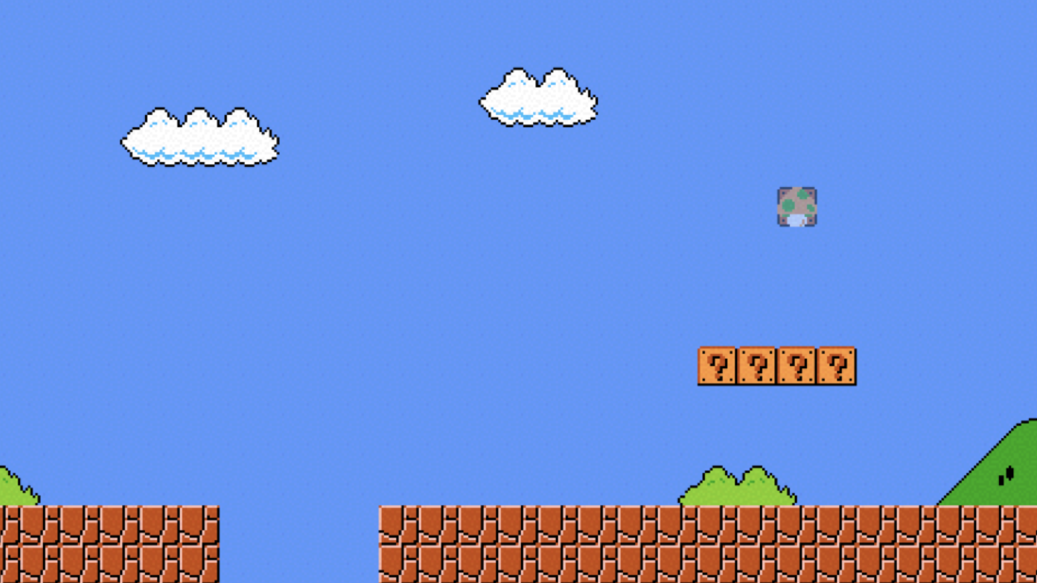

Slide 176
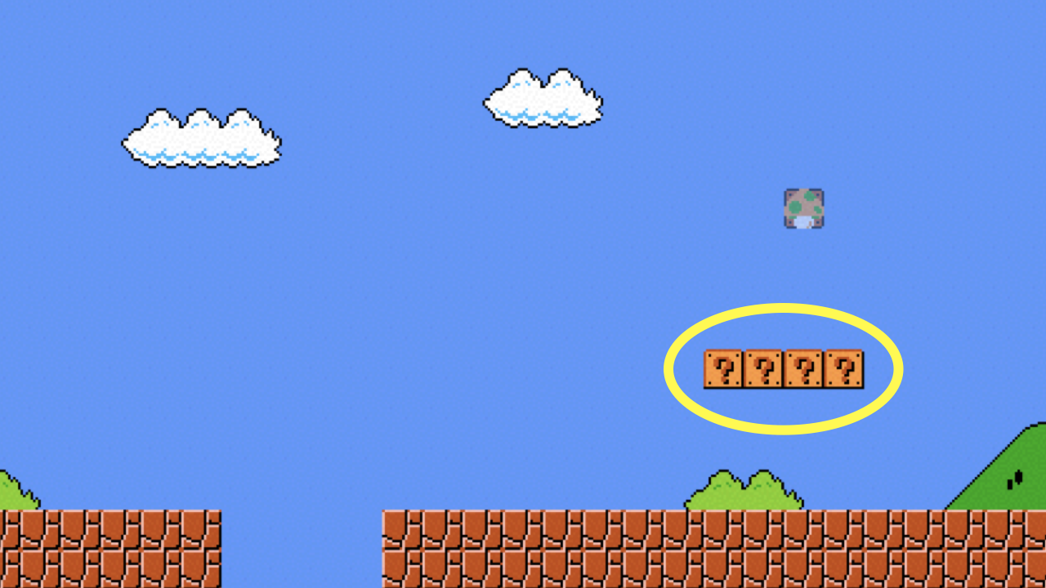
Notes:
mario{0,1}.c

Slide 177
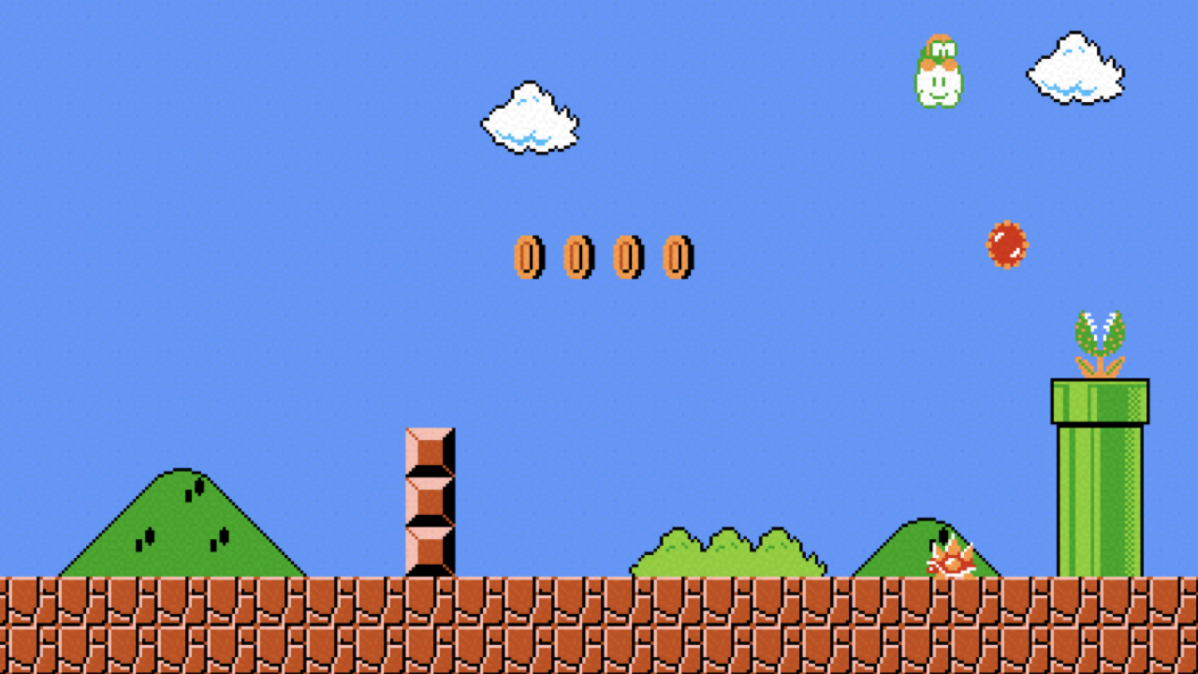

Slide 178
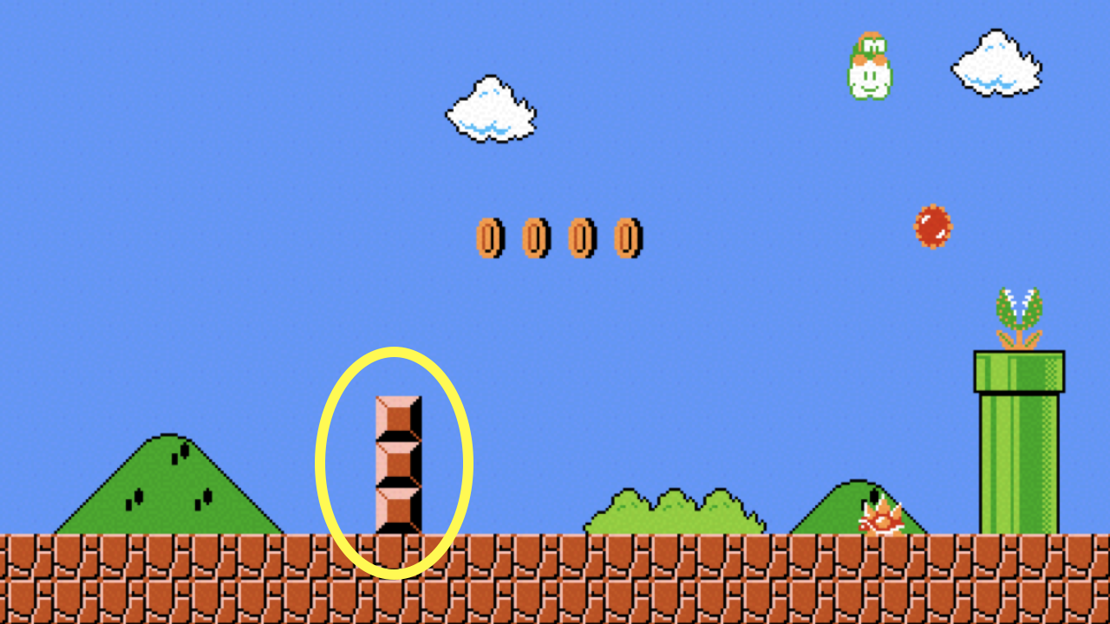
Notes:
mario2.c

Slide 179
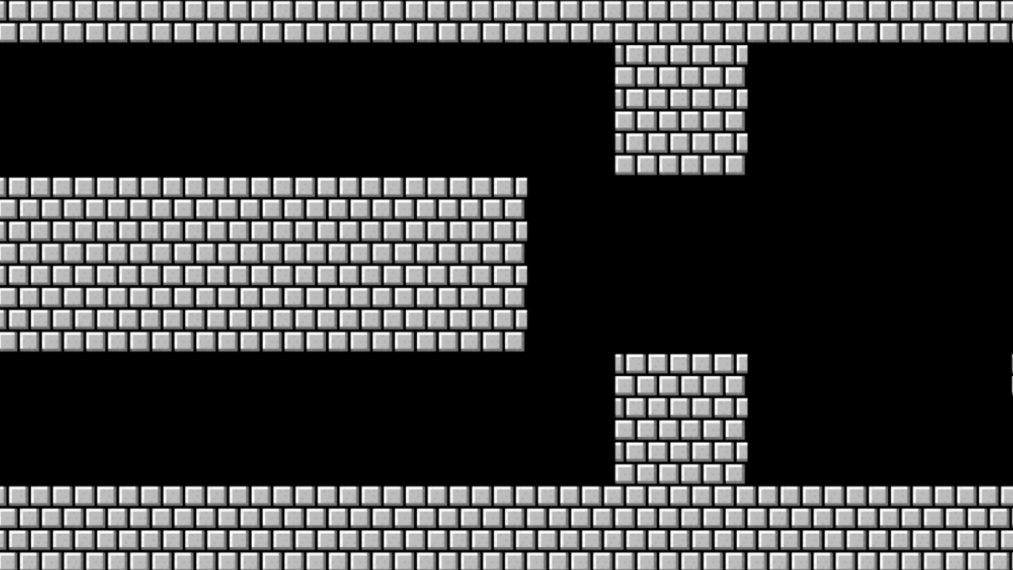

Slide 180
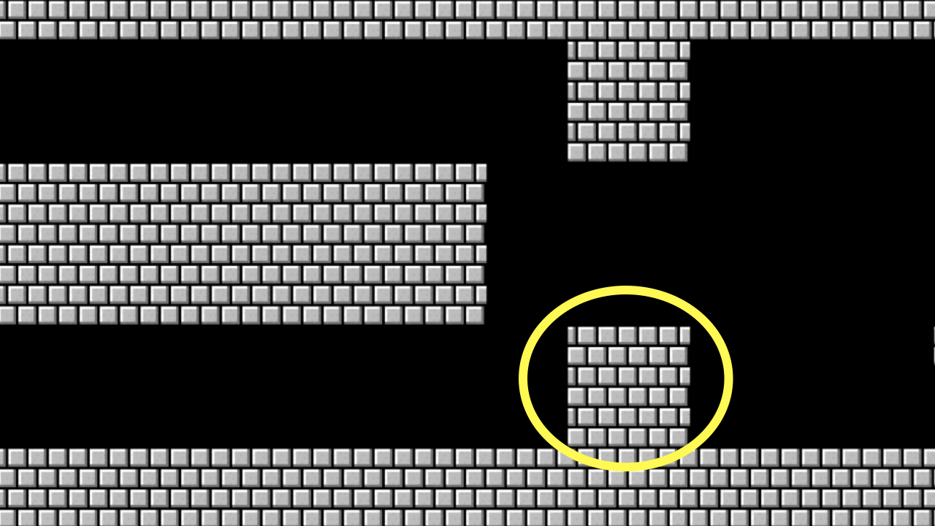
Notes:
mario{3,4}.c

Slide 181
constants

Slide 182
comments

Slide 183
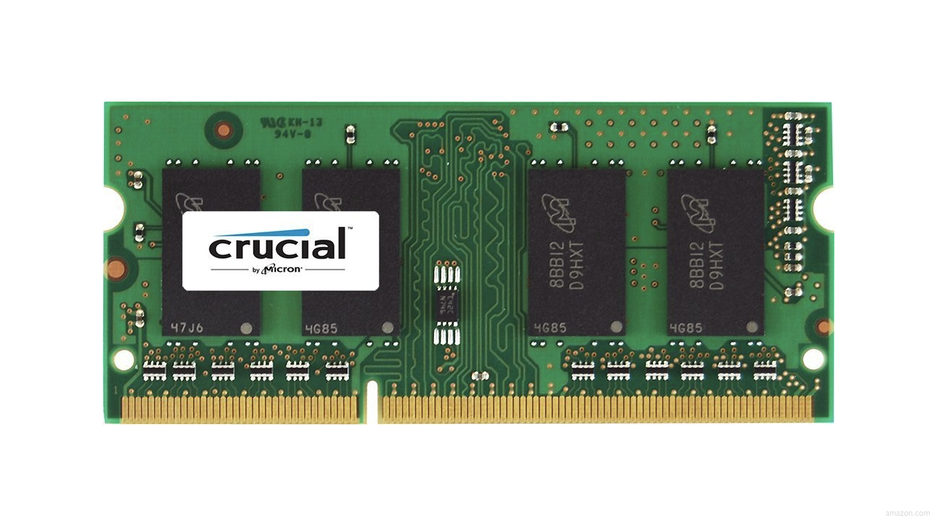

Slide 184
0000

Slide 185
0001

Slide 186
0010

Slide 187
0011

Slide 188
0100

Slide 189
0101

Slide 190
0110

Slide 191
0111

Slide 192
1000

Slide 193
integer overflow

Slide 194
00000000000000000000000000000000

Slide 195
11111111111111111111111111111111

Slide 196
4294967295

Slide 197
2147483647

Slide 198
-2147483648

Slide 199
bool
char
double
float
int
long
string
...

Slide 200
bool
char
double
float
int
long
string
...

Slide 201
get_char
get_double
get_float
get_int
get_long
get_string
...

Slide 202
get_char
get_double
get_float
get_int
get_long
get_string
...

Slide 203
%c
%f
%i
%li
%s

Slide 204
%c
%f
%i
%li
%s

Slide 205
9223372036854775807
Notes:
2^63 - 1
9 quintillion

Slide 206
truncation
Notes:
calculator5.c

Slide 207
bool
char
double
float
int
long
string
...

Slide 208
bool
char
double
float
int
long
string
...

Slide 209
get_char
get_double
get_float
get_int
get_long
get_string
...

Slide 210
%c
%f
%i
%li
%s
Notes:
calculator{6,7}.c

Slide 211
type casting
Notes:
calculator8.c

Slide 212
floating-point imprecision
Notes:
1/3
calculator{9,10}.c

Slide 213
1999
Notes:
graduated

Slide 214
1999

Slide 215
1900

Slide 216
19 January 2038

Slide 217
13 December 1901

Slide 218
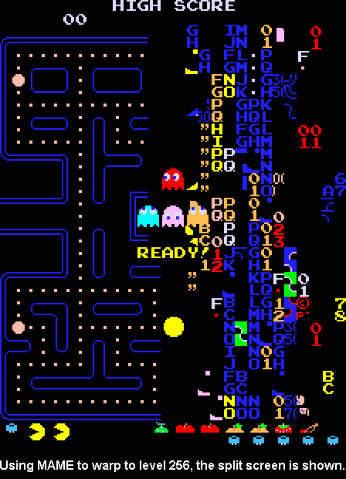
Notes:
https://pacman.fandom.com/wiki/Map_256_Glitch
"The level counter in the original Pac-Man is stored as an 8-bit integer, meaning the highest value it can hold is 255. The level counter starts with 0 internally, but for calculating the fruit counter it adds 1; however, because of overflow, adding 1 to 255 would result in 0, and the game tries to count fruits from 1, causing the game to attempt to draw 256 fruit to the screen until it overflows to 0. The result is the garbled mess on the right side of the maze, because the screen memory starts with the bottom, followed by the columns from the right side."

Slide 219
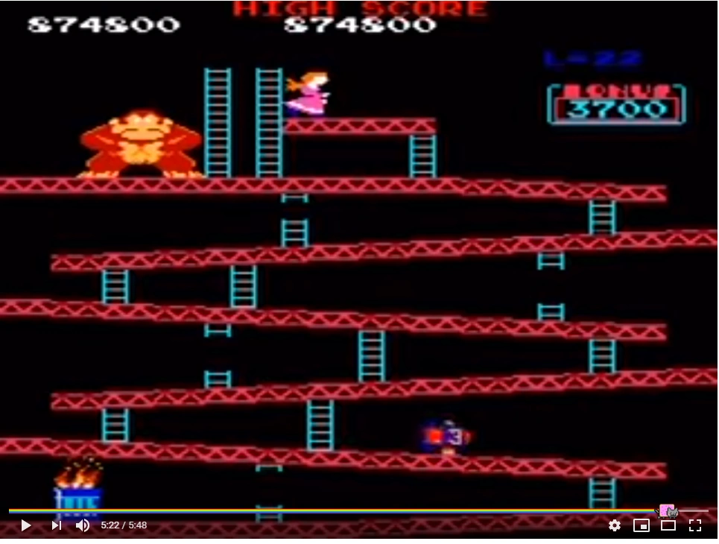
Notes:
https://errors.fandom.com/wiki/DK_kill_screen
"Like most kill screens, this kill screen is the result of integer overflow on an 8 bit variable. The amount of time allowed for any given screen is determined algorithmically during play by the level the player is on. The timer is calculated in seconds as 10×(level + 4), and has a maximum value of 80. When the level reaches 22, the game reads 10×(22+4) or 260 seconds. However, the 8-bit counter rolls over at 256, meaning the game calculates 4. This causes the timer to be set so low that there is 4 seconds for the player to complete the level, simply not enough time for the screen to possibly be completed, Unless you are playing on Japanese Set 3. On that version, there is a bug in 25m where if you jump at a certain point, you fall through the floor, Then Mario’s y position overflows to 0, and you complete the screen."

Slide 220
10 × (level + 4)
Notes:
timer

Slide 221
10 × (22 + 4)

Slide 222
260

Slide 223
4

Slide 224
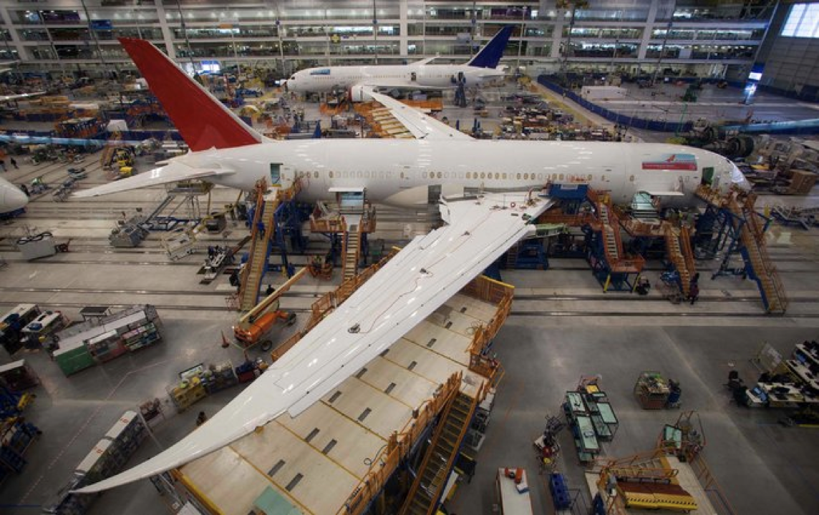
Notes:
Boeing 787
"a Model 787 airplane that has been powered continuously for 248 days can lose all alternating current (AC) electrical power due to the generator control units (GCUs) simultaneously going into failsafe mode," the memo stated. "This condition is caused by a software counter internal to the GCUs that will overflow after 248 days of continuous power... Boeing is in the process of developing a GCU software upgrade that will remedy the unsafe condition." - http://arstechnica.com/information-technology/2015/05/boeing-787-dreamliners-contain-a-potentially-catastrophic-software-bug/
A simple guess suggests the the problem is a signed 32-bit overflow as 2^31 is the number of seconds in 248 days multiplied by 100, i.e. a counter in hundredths of of a second.
https://www.i-programmer.info/news/149-security/8548-reboot-your-dreamliner-every-248-days-to-avoid-integer-overflow.html

Slide 225
correctness, design, style

